Slide 1
EDINBURGH NAPIER UNIVERSITY EXERCISE THRESHOLDS APP
A PLATFORM FOR VISUALISING BREATH-BY-BREATH ANALYSIS
Notes:
Robert: Good morning everyone. Today we would like to discuss our project; the Edinburgh Napier University Exercise Thresholds App

Slide 2
CONTENTS
Introduction
Web Design
User Login
Messaging Service
Uploading and Importing Breath-by-breath analysis data file
Processing Breath-by-breath analysis data file
Data visualisation
Application Video Demonstration
Limitations and Improvements
Questions
Notes:
Robert: So here is a roadmap of what we will be discussing today. I will introduce you to the application before handing over to my team to discuss the technical work they did, before concluding with limitations, possible improvements and questions

Slide 3
MEET THE TEAM
Robert Denny: Project Manager
Kaitlin Carlon: Web Designer
Niamh Syme: Web Designer
Aaron Morrison: Development Planner
Michal Boduch: Back-End Developer
Alexandru Pintea: Back-End Developer
Notes:
Robert: Firstly, I will introduce the team, I am Robert, I was the project manager. Kaitlin and Niamh were our web designers, Aaron was named development planner, he created the original class diagram and helped me to coordinate back-end code development as he had a better understanding of the coding aspect of the project than I did. He also assisted in early coding. Michal and Alexandru were responsible for the majority of the code that makes up the application.

Slide 4
WHAT IS OUR APPLICATION?
The application is aimed at sport enthusiasts and exercise researchers that want to visualise breath-by-breath analysis, or want to communicate with others that wish to improve and compare their workout routines.
The Main attributes used for this application were; VO2 Max and VCO2 Max, among others.
The final application was built using Python, SQL and Js with a web-based User Interface.
Notes:
Robert: So, what is our application? Well, it is an application aimed at sports enthusiasts and exercise researchers that is used to visualise a rather complex set of data known as Breath-by-breath analysis. This type of data is used by researchers to discover optimal exercise patterns and routines that sports enthusiasts can use to better improve their programs and lifestyles. Our client wished for our application to focus on a few of the key attributes of the many different attributes that a full breath-by-breath analysis provides. The main attributes the client asked us to focus on were VO2 Max, which is how much oxygen a person uses during exercise, and VCO2 Max, which is how much Carbon Dioxide a person exhales during exercise, though there are many other attributes that are recorded and can be analysed for different purposes.

Slide 5
THE ORIGINAL DELIVERABLES MAP
Must have: • Breath-by-breath analysis raw data transformation.
• Login and access for senior staff.
• Login and access for researchers.
• Upload of Excel/ .CSV file.
• Data visualisation.
Should have: • Generated digital reports based on personal metabolic carts results (PDF).
• Source code of the project in the appropriate repository.
• Data-flow system that allows discussion between researchers and sign off from senior staff
• Documentation of the project.
Could have: • Slider graphs.
Won’t have: • Submit findings for approval.
Notes:
Robert: So, now that you have a basic idea of what we set out to achieve, I show you our original deliverables map. Out of all the features on this map, the only one we did not successfully implement was the Could have feature: Slider graphs. Everything else shown here was achieved in some way. Now, that we’ve introduced you to the project, I will briefly discuss the web design process.

Slide 6




DESIGN OF THE WEBSITE
The website was originally built on Squarespace and was designed to be modern and simple to use.
The final version looks and feels significantly different from Niamh and Kaitlin’s original design due to late development changes
In accordance with client’s requests, the charts on the website and result.pdf have been marked with the Edinburgh Napier University logo.
This selection of concept logos shown matched the character of the application.
The Logo of the application was initially designed by Niamh, then modified by the whole team.
Notes:
Robert: So, originally, Niamh and Kaitlin designed the website, and they were going to discuss it here, but in their absence I shall briefly discuss their design. The original plan for the website user interface was to design a modern easy to use website on Squarespace, then transition that design to a WordPress template for efficient connection to the back-end python code. In the early stages of development Aaron researched how to do this, and said it could be a complex task, but he had experience with WordPress and Python so he believed he could accomplish it in the way we intended. Unfortunately, he fell out of communication with the rest of the group, and we had to change our approach late in development.
Niamh and Kaitlin’s original website featured a sleek, modern design with various contact information present and images used to illustrate the purpose and use cases of the application to users. It was styled in a way that made it blend into the rest of the Napier websites as the client requested, while still having it’s own identity so that users could feel comfortable with the service even if they had no connection to the University. It featured the Napier University logo as well as our own logo that Niamh designed for the application.
In the final version, we used Niamh and Kaitlin’s creation as a base for the UI, this meant that we lost some of the original design in the transition, which isn’t the fault of the developers, who had little time to get a lot of work done, but it is an unfortunate side effect of changing our plans so late in development. The final design is still efficient and responsive; however, it looks less modern and a little less easy to use.
The logo was originally created by Niamh, and went through several reversions…

Slide 7
LOGO DECISION
Out of all the logos shown, we decided that the best logo for our application would be the one below, since it is simple and easy to read, yet effective at conveying what our application is about to new users.
Notes:
Robert: With the team eventually deciding upon this logo. We chose this one as we believed it was simple, yet effective at conveying the basics of our app. It features a person running, which connotes sporting activities. Sports enthusiasts and researchers are the main demographic for our application so a logo that directly references that makes sense. The choice to have the person running also suggests cardio exercise, which is traditionally the type of exercise monitored by breath-by-breath analysis, adding more references to the sports industry.

Slide 8
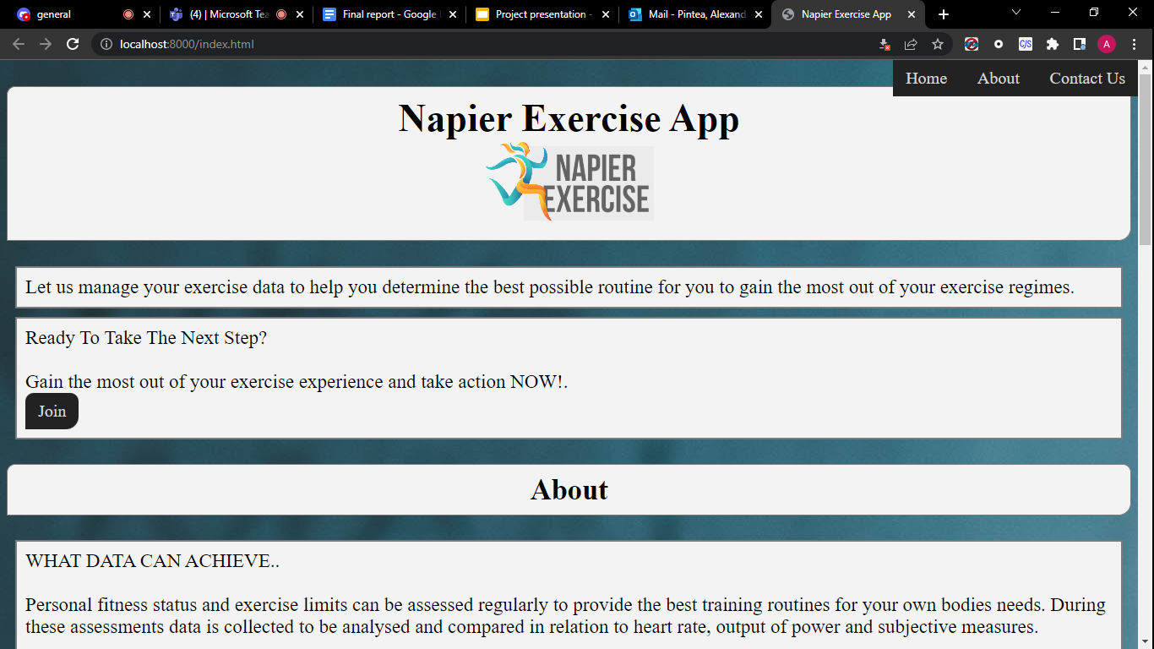
APPLICATION HOME SCREEN
Notes:
Robert: Here we have the home screen of our final application, we will show you more of the apps functionality during the demonstration, however, this is just to give you a feel for the design.

Slide 9
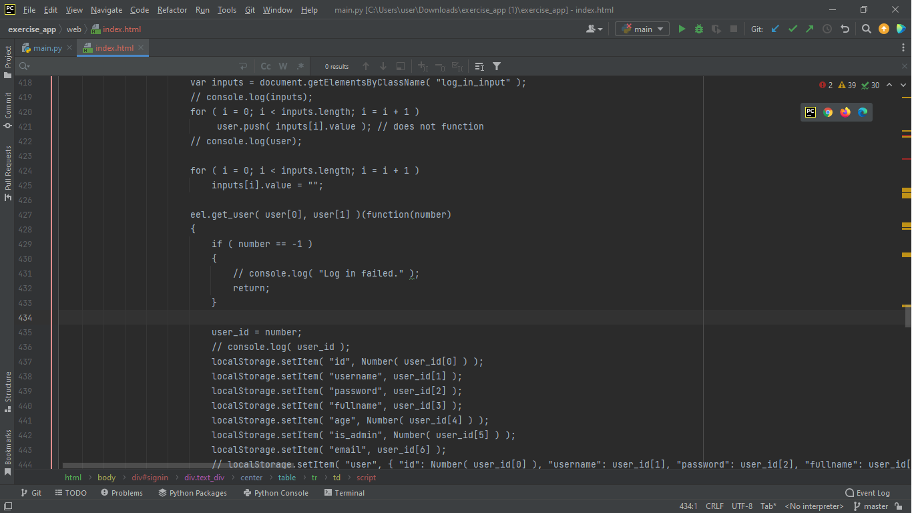
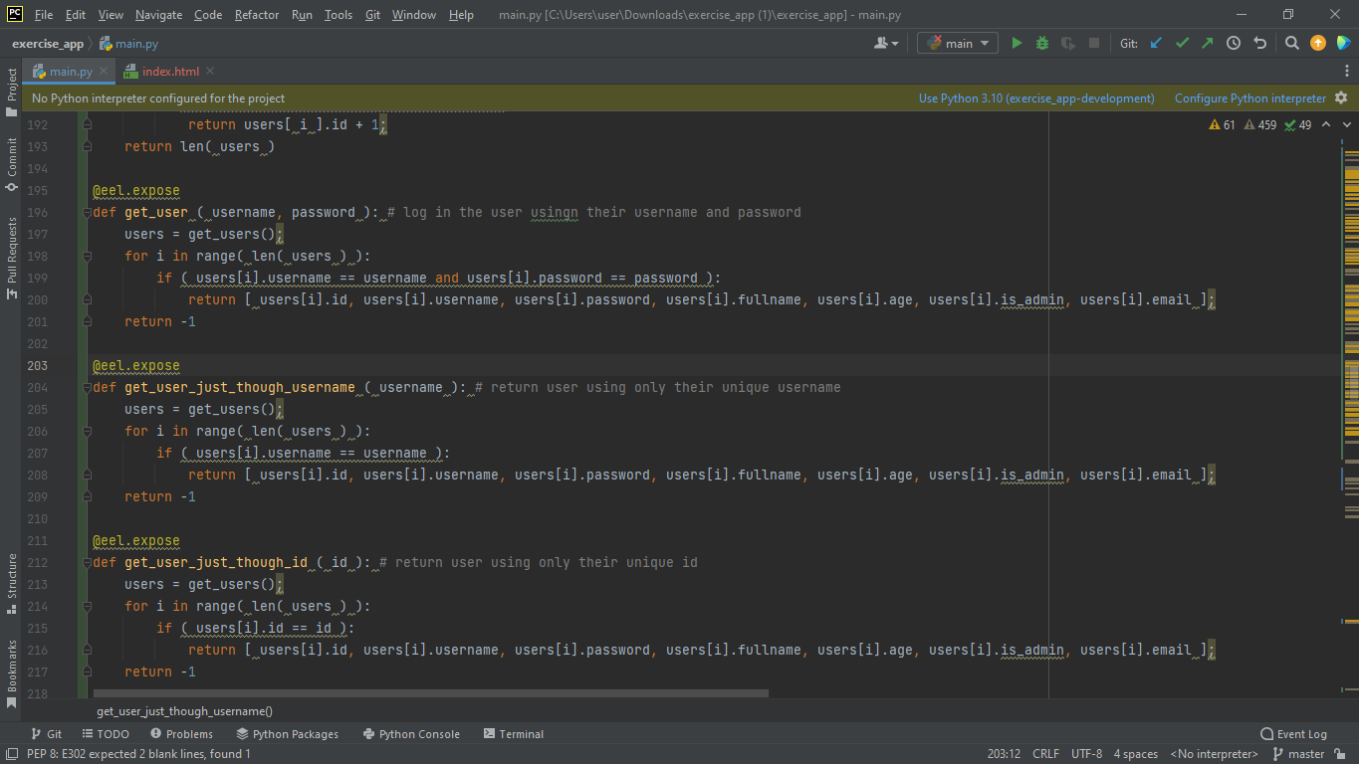
LOGIN AND ACCESS FOR SENIOR STAFF
The login module consists of Python and JavaScript functions that communicate then query the SQL server for accuracy of the user data ( username and password ) that the user provides.
The Js Eel call for the Python function declared below
Python function used to allow a user to login:
Notes:
Alexandru: The first action that a user needs to take when using the message part of the application is the log in. The log in functions take the username and password and verify them to match the data in the SQL database. Here you can see a Python function being called in Js using Eel. If the user does not have an account, they can sign up, as I am going to show when we execute the application. For now, let's take a look at the classes that our application uses.

Slide 10
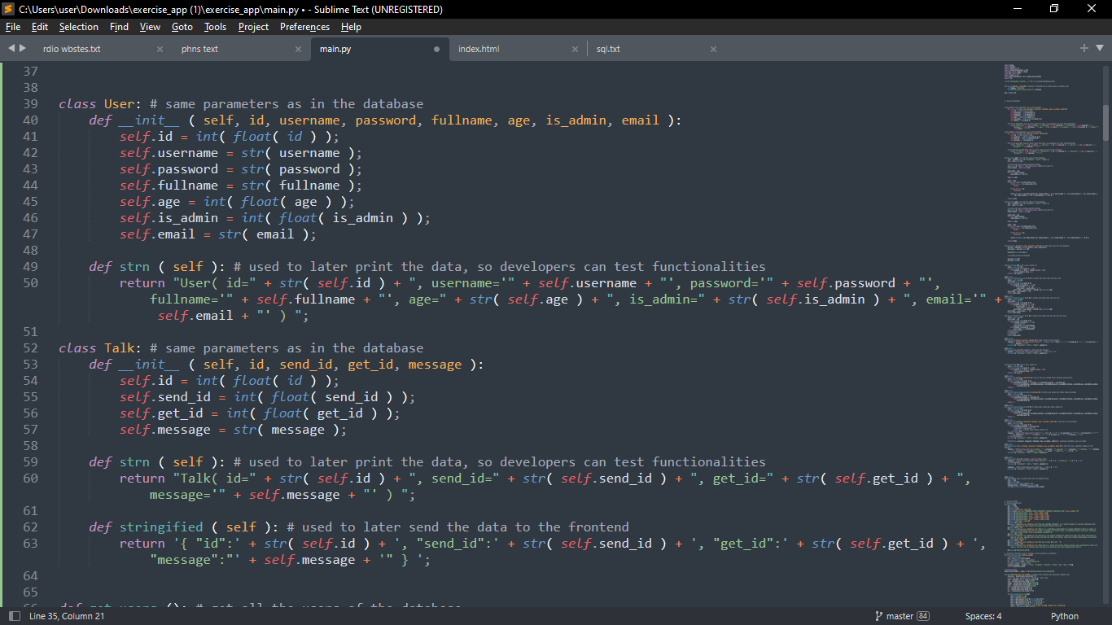
MESSAGING BETWEEN STAFF MEMBERS
The system uses 2 Python classes correlated with 2 SQL tables for users and talks.
The database parameters are used, and functions were made for formatting the class data for the developers (strn() functions).
There is a stringified() function for formatting the data to be sent to the front-end
Notes:
Alexandru: We only used classes for the communication feature of the application. Therefore we have classes for Users and for Talks, the last referring to the the messages that users send to each other. Besides their parameters, they have constructors and functions that concatenate all their properties into a string. Such functions are used in development, and in an instance to send data to the UI.

Slide 11
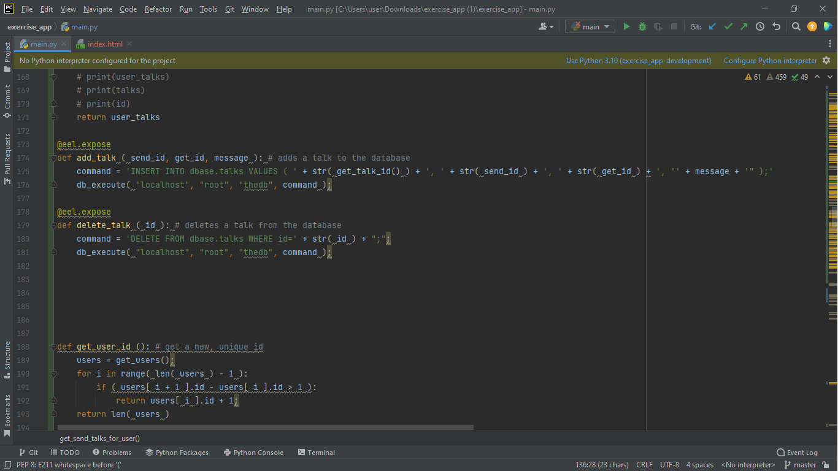
MESSAGING BETWEEN STAFF MEMBERS
Each user can send another user a “talk”, meaning a message.
Regular users are able to send and receive messages, admins are able to also delete them
Notes:
Alexandru: Here, the mechanism of the sending messages is shown. The ids of the users sending and getting the message are used to define a message.More details on that later, when we execute the application.

Slide 12
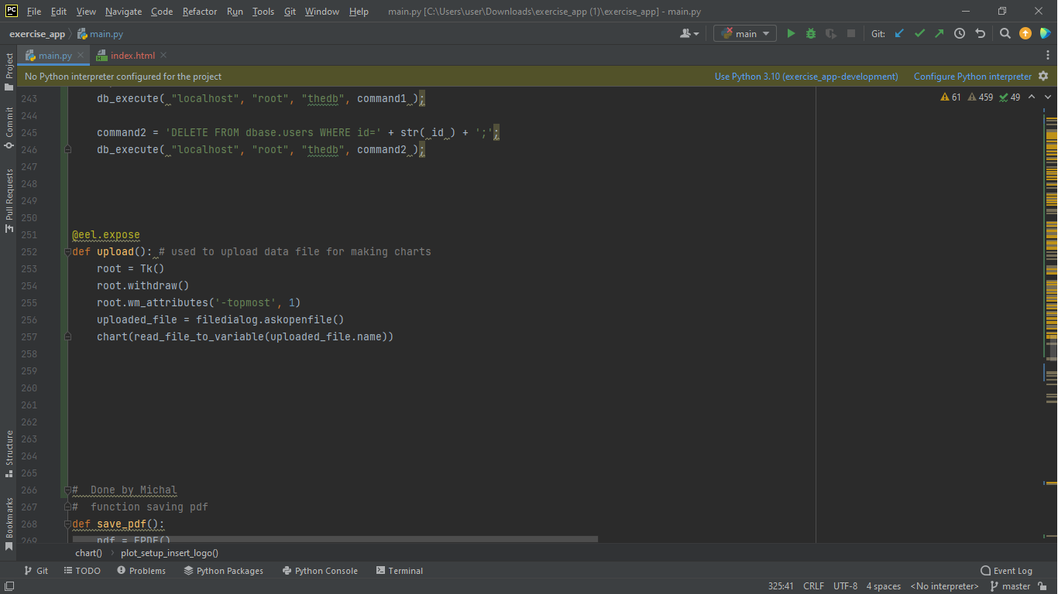
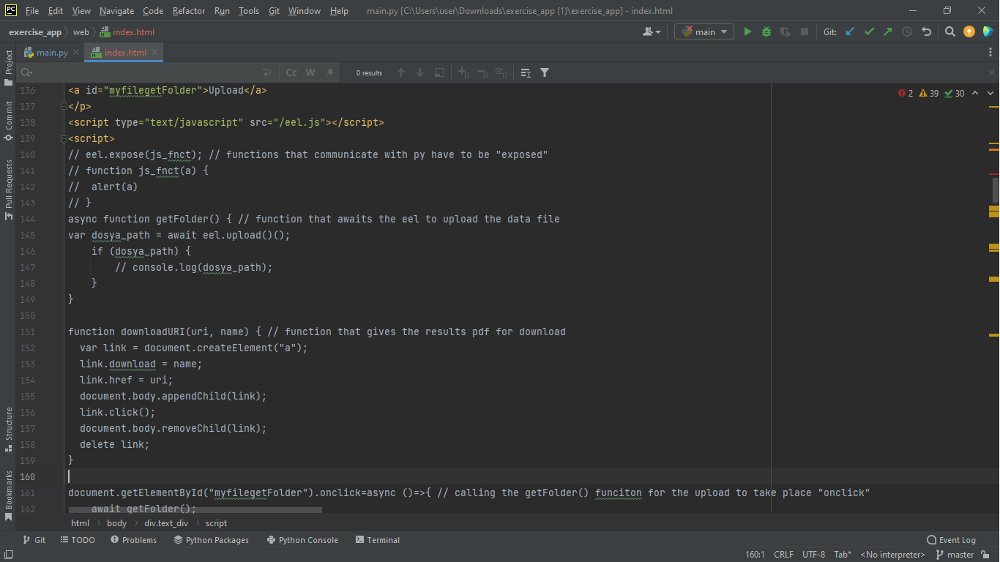
UPLOADING AND IMPORTING RAW DATA FILES
This feature opens a file selection dialog that is used to select a breath-by-breath analysis data file.
File loading is achieved by a Js function that uses a Python-declared eel function to import an XLSX file (Excel file). The read_file_to_variable function receives the loaded file as argument.
Notes:
Alexandru: Besides the communication feature, out application is able to examine the breath-by-breath analysis contained in a raw data file. A breath-by-breath analysis file can be uploaded (using Js) to the application’s Python back-end.We did that by using Eel, a Python package that enables developers to use Python functions in Js and the other way around. Michal took care of turning the data file into PDF charts as he is going to discuss now.

Slide 13
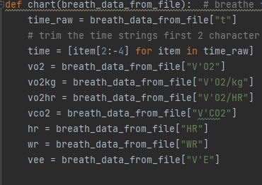
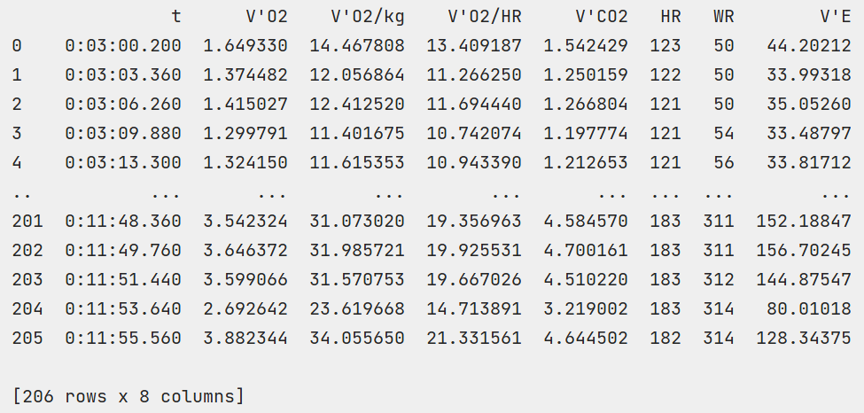
PROCESSING OF RAW DATA FILE
The imported Excel file is moved into an array ( Python: chart(breath_data_from) using breath_data_from_file() ) with the key columns for analysis. The array contains the following columns: t (time), V'O2, V'O2/kg, V'O2/HR, V'CO2, HR, WR, V'E. The t (time) column rows are trimmed. The first two and last four characters are removed as they are non-essential for data visualisation. Result of an extraction from a Excel data file is shown below, along with a portion of related code.
Notes:
Michal: The processing of uploaded file starts when Js code passes it to Python. The breath-by-breath analysis file consists of measurements taken at certain intervals, which are kept as rows of a table. The chart() function takes the data as parameter, creates charts and saves them as PNG files. The client pointed out which columns of the file are important for visualizations. The figure on the right shows a listing of extracted columns, and the one on the left represents its corresponding code.

Slide 14
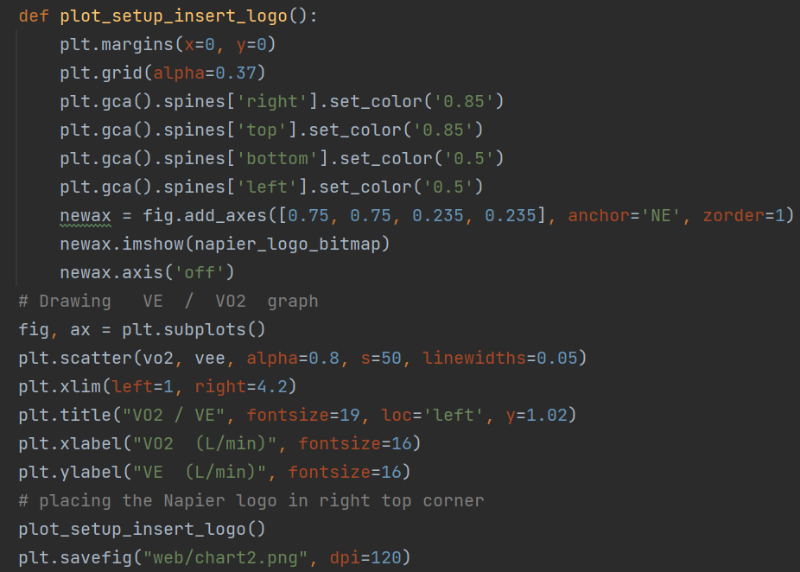
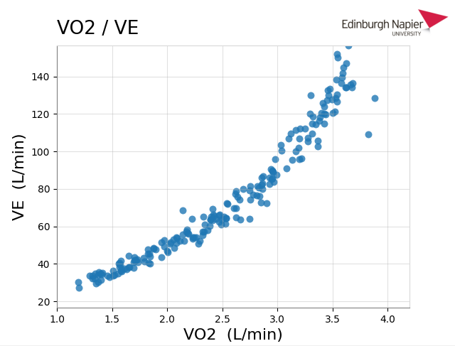
DATA VISUALISATION
Matplotlib.pyplot libraries have been used for visualisations of selected column pairs. Once the raw breath-by-breath analysis data file has been loaded and the columns extracted, the charts are made. Examples of visualised pairs of columns are shown below and on the next slide. Each chart contains the Edinburgh Napier University logo. Five charts are generated by chart(breath_data_from_file) function.
Notes:
Michal: The chart() function takes the selected columns from imported file and each section of the function generates a chart. The Python matlibplot library offers a variety of chart-making options, but the client requested stochastic and two dimensional also pairs of data for visualization were provided by the client. The script on the left shows code used to generate stochastic chart visible on picture on the right

Slide 15
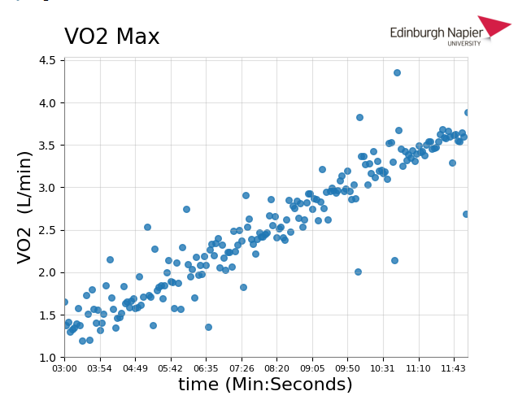
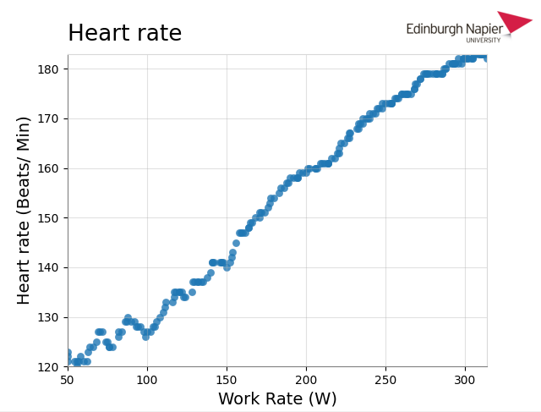
DATA VISUALISATION
The charts proportions are limited to normal values to avoid showing outliers. This setup maximizes readability and clarity.
Notes:
Michal: Sometimes the breath-by-breath analysis contains outliers which could decrease clarity of the charts. Certain axis was limited to normal values to maximize clarity.

Slide 16
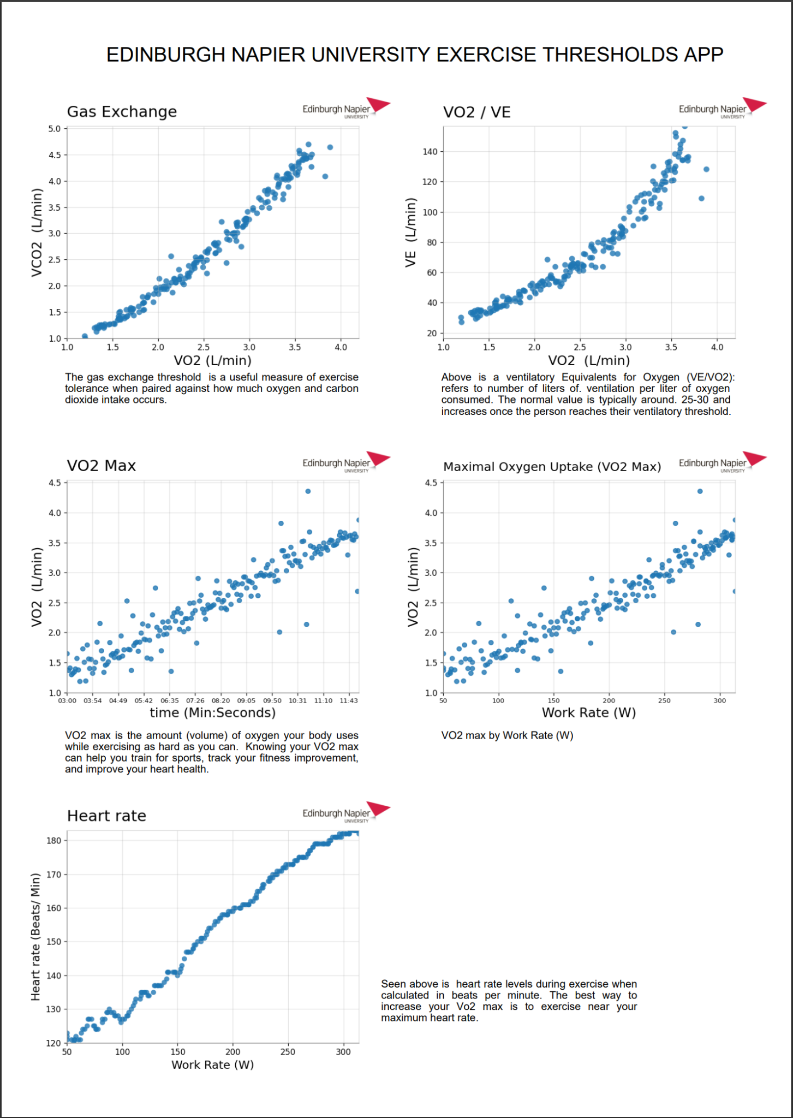
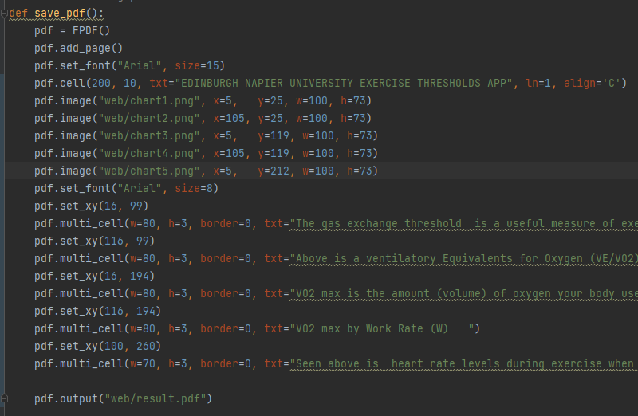
RESULTS SHOWN IN PDF FORMAT
The save_pdf() function uses the FPDF library functions to add multiple text fields and PNG files on one PDF page. Once the five generated bitmaps are setup on the page and text placed in with appropriate coordinates - the function saves the report to a PDF file, which is then ready to download and view.
Notes:
Michael: Pythons FPDF library allows to insert text boxes and pictures with specified coordinates and dimensions to create PDF document.
The function save_pdf(), visible in the left, takes the 5 generated PNG files, inserts title and chart descriptions and saves the created document as a PDF file.

Slide 17
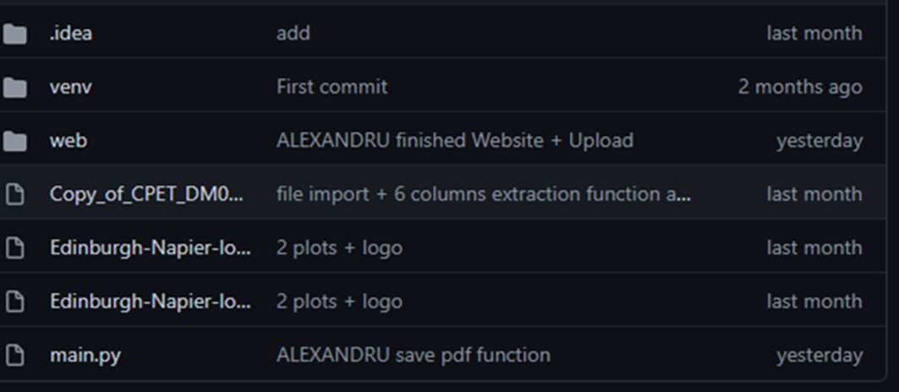
GITHUB REPOSITORY
The final version of source code has been stored on GitHub repository:
https://github.com/napier-group-project/exercise_app
Notes:
Robert: The client requested that all the code required for the application to run was stored in an appropriate repository. We chose GitHub for it’s reliability and ease of use.

Slide 18
APPLICATION EXECUTION
(running or video of it running)
We would now like to present our application running in real time to show you it’s full functionality in person.
Notes:
Alexandru: Now I am going to show you a video of the application being executed, and pause to explain the code involved in each featured that is being used in this video.

Slide 19
LIMITATIONS OF OUR APPLICATION
The messages shown to the user have to be refreshed constantly, meaning a user occasionally sees text appearing and disappearing when messages are refreshing.
The application can only be used in one webpage, without refreshing it (an Eel limitation that could not be solved).
Some sensitive user data is kept on the front-end (due to Eel not keeping data about the logged in user)
The UI is not as user-friendly as we originally intended and designed.
Notes:
Robert: So, before we conclude with questions, I will take a brief moment to discuss a few limitations of our application and how we could fix them.
Firstly, messages that are shown to the user have to be refreshed constantly, which means they can see the text appearing and disappearing as the text is refreshed. This is not a major issue, more of a minor annoyance, but we still believe it is something that should be addressed.
Secondly, due to a limitation with our Eel implementation, the application can only be used in one webpage, meaning that if a user exits the webpage the app will stop working.
Thirdly, some sensitive data is stored on the front end, which isn’t a huge issue, but it is not ideal.
Finally, the final user interface is not as user friendly as we originally intended and designed, due to the previously mentioned late development changes.

Slide 20
HOW THOSE LIMITATIONS COULD BE FIXED
Different ways in which the messages are updated need to be researched. Using some Js or maybe even a more complex Python library could prove to be the solution
Eel arguments that if their eel.js file is included in a webpage, Eel should not stop when moving to that webpage. Attempts at that have proved otherwise, however there might be more truth to the claims that Eel makes. Further research could help clear that up.
A good Python library for storing the logged user data on the back-end could be researched, then implemented
The best solution to this issue would be to implement our original vision for the UI.
Notes:
Robert: For messages constantly needing to be refreshed, a potential solution could be to alter the way they are updated, perhaps by making it a front-end task as opposed to a back-end task could solve this, or there is the option of using more complex python libraries to achieve better updating of messages.
For the app not working if you leave the webpage, further research could be done into Eel as they say this should not be an issue, however, our testing proved otherwise.
Thirdly, to fix data being stored on the front-end, more complex python libraries could be used to store data more efficiently on the back end.
Finally, in terms of the UI issue, the obvious solution would be for our original concept to be fully realised, allowing for a more modern, easier to use and understand UI

Slide 21
POSSIBLE FUTURE DEVELOPMENTS
The application could be adapted for every screen size.
The admin could be given the ability to be able to see all messages and users, as well as delete them.
The app could allow for multiple users to communicate in groups.
Notes:
Robert: In terms of ways our application could be further expanded, aside from addressing the limitations mentioned previously, we believe the application could be adapted for all screen sizes. During the design of the UI, Niamh asked if we should create a version for Smartphones as well as desktop, we went to the client with this question at the midpoint meeting and he deemed it an interesting idea, however, it was outside the scope of this particular project.
A feature to allow admins to see all messages and users could also be implemented, however, this could pose privacy concerns.
The messaging service could be expanded to allow for multiple users to communicate in groups, to better compare results.

Slide 22
QUESTIONS
Thank You for your Attention!
Notes:
Robert: Thank you for listening to our presentation, if there are any questions, we would be happy to try and answer them now.
[Questions]
Robert: If that is all the questions, we thank you once again for your attention, and we hope you enjoyed this presentation.

